Slide 1
Bazele inteligenței artificiale
Laborator – Grigore Ionuț

Slide 2


today’s lab

Slide 3
Content
Attention pooling: Nadaraya-Watson kernel regression
Attention scoring functions
Bahdanau attention
Multi-head attention
Self-attention and positional encoding
Transformer

Slide 4
1) Attention pooling: Nadaraya-Watson kernel regression

Slide 5
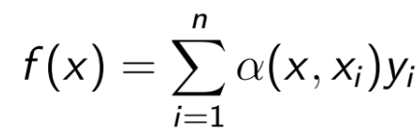



it’s a simple example for demonstrating the power of attention mechanism in ML
regression problem: given a dataset of input-output pairs {(x₁, y₁), (x₂, y₂), …, (x_{n}, y_{n})}, how to learn f to predict the output ŷ = f(x) for any new input x?
solution: write f as:
key
value
query
attention weight

Slide 6

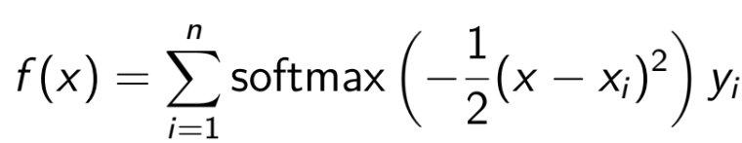
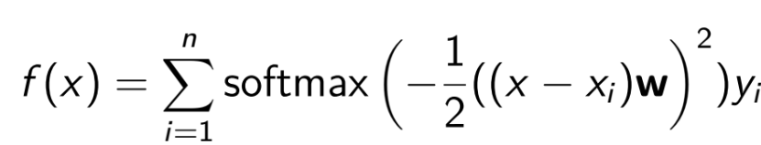

question: how do we choose the attention weight ?
answer: the sky is the limit ☺
some examples (Nadaraya-Watson attention models):
non-parametric model: we don’t have any weights or biases to learn
parametric model: we have w which is a learnable parameter
Why this formula with softmax? We will explain it in the next slides ☺

Slide 7

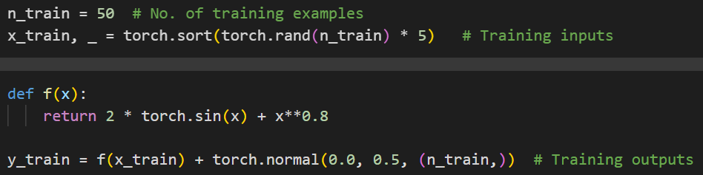
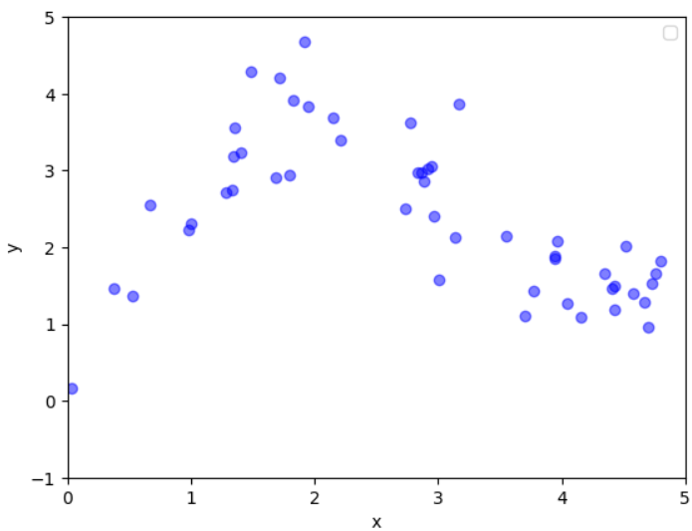

we generate an artificial dataset according to the following nonlinear function, with the noise term ϵ:
we generated 50 input-output pairs {(x₁, y₁), (x₂, y₂), …, (x₅₀, y₅₀)}

Slide 8
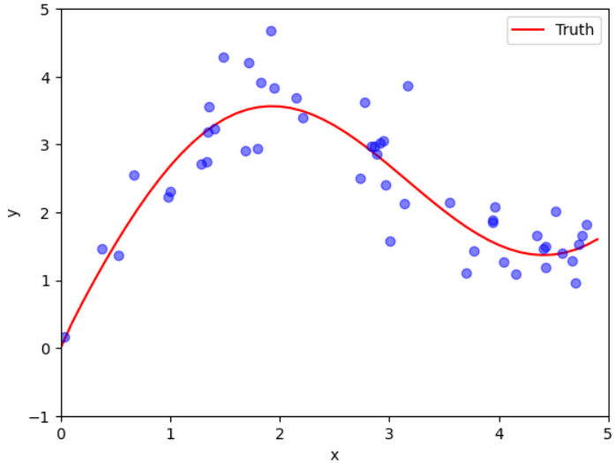

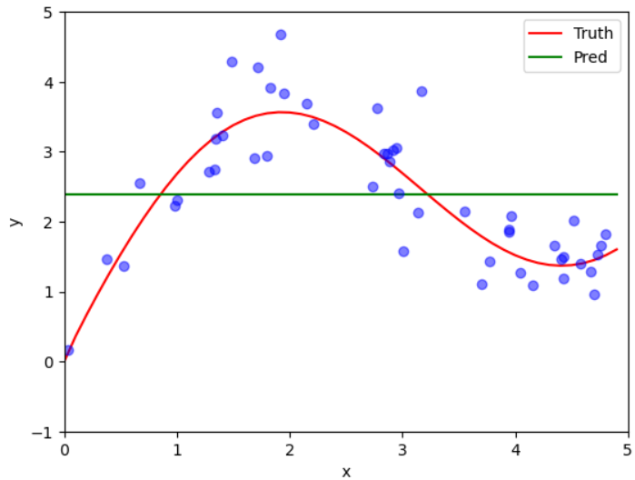


our goal: we want to learn to estimate the blue line:
one (stupid) solution:

Slide 9

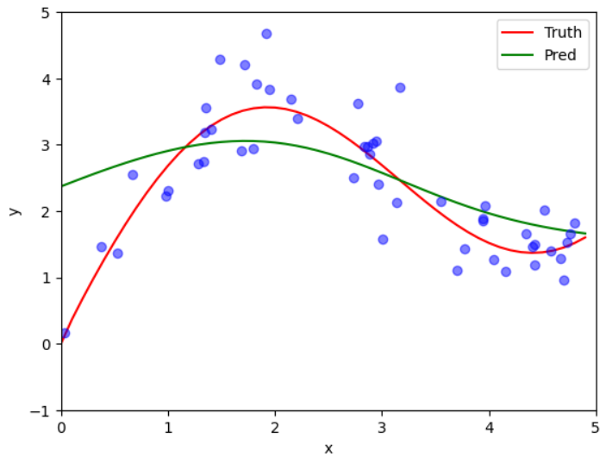


one (smart) solution:

Slide 10

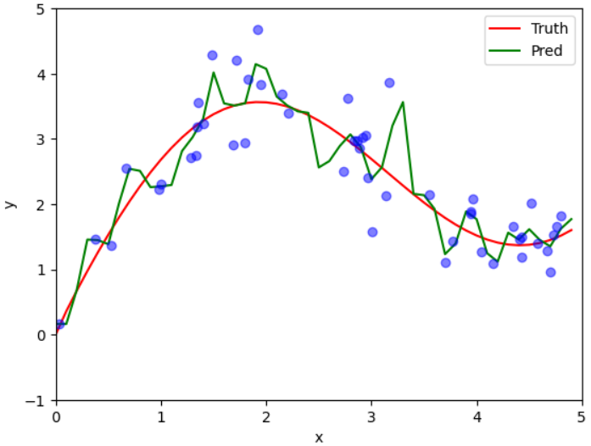
one (genius) solution:
we need to train this model to find w
after training and finding the best w
you have the NWKernelRergession class and the training loop already done in lab

Slide 11


Slide 12
2) Attention scoring functions

Slide 13
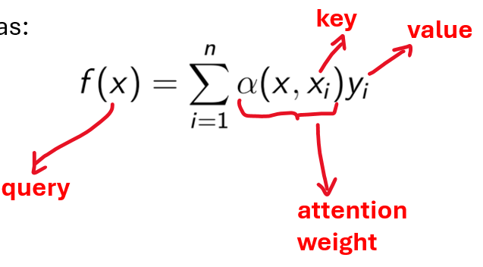

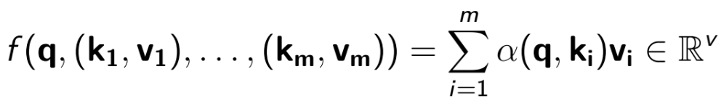


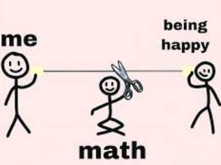


remember this?
(slide 5)
let's write it more mathematically:
- a scalar ( a number ☺ )

Slide 14
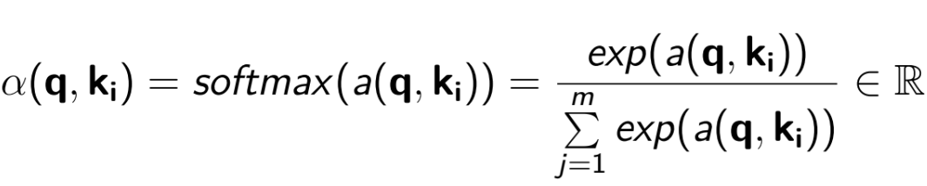
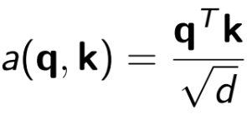











scoring function
scoring functions:
learnable weights
- additive attention
- scaled-dot product attention
len(q)

Slide 15
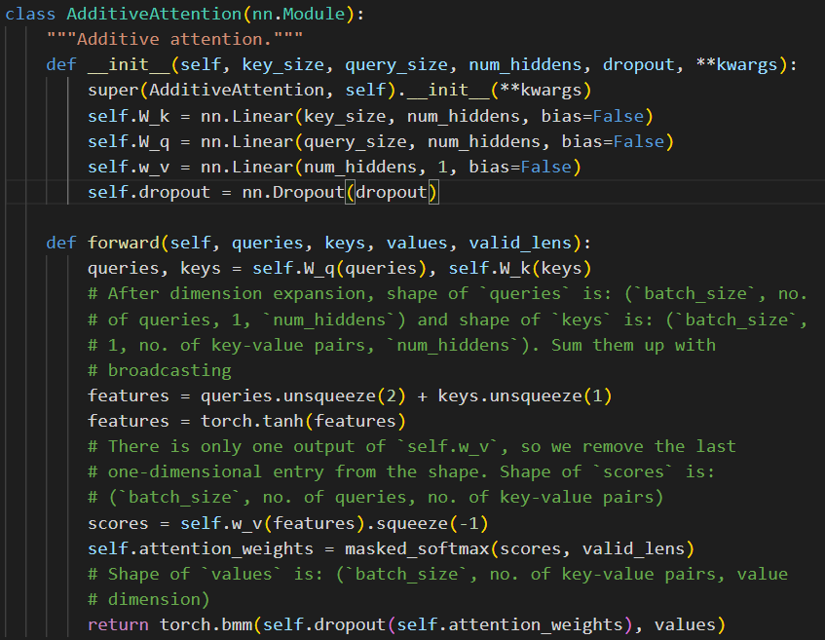
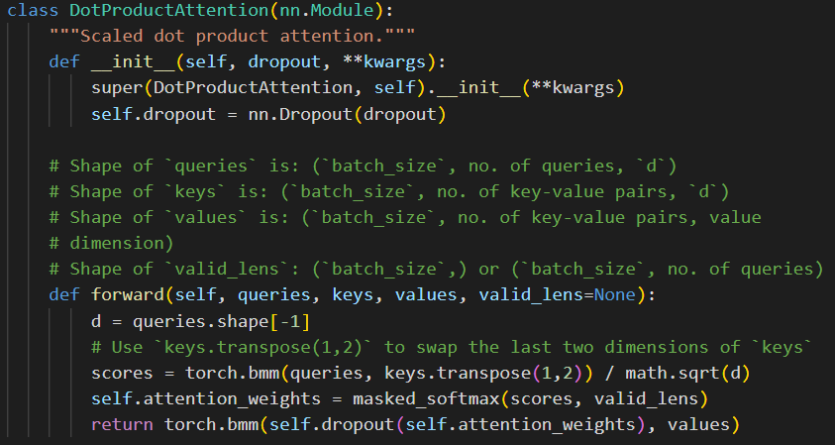
We have the classes for implementing these scoring functions in lab but we will explain them later with an example:

Slide 16
3) Bahdanau attention

Slide 17

(fixed length)
“Cum vi se pare laboratorul de BIA?”
(variable length)
“How do you like the BIA lab?”
(variable length)
RNNs
Remember this from the previous lab? We used 2 RNNs as encoder-decoder model to translate from one language to other (see next 2 slides):

Slide 18
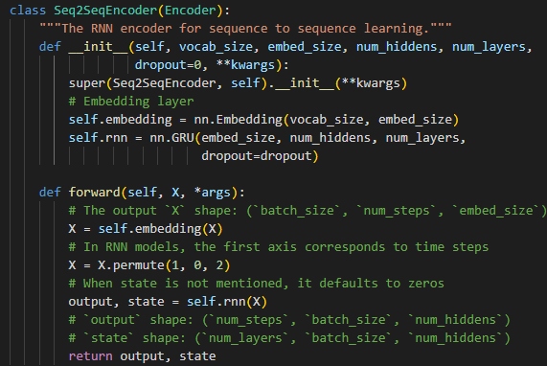
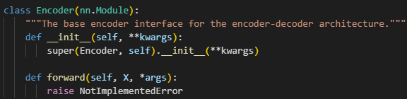
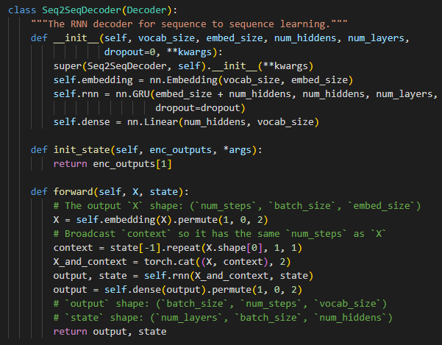
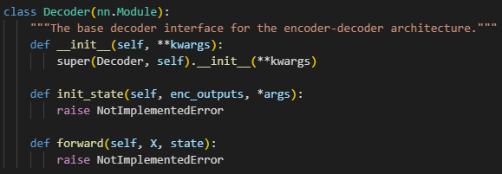
Model
2 RNNs: one for encoder and one for decoder:

Slide 19
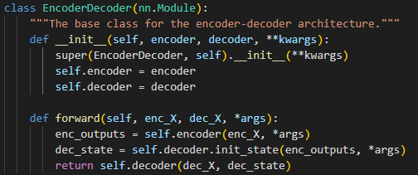
these are specified in the problem
this is the model used for training in lab 10 ☺
we needed to use 5 classes to obtain it

Slide 20


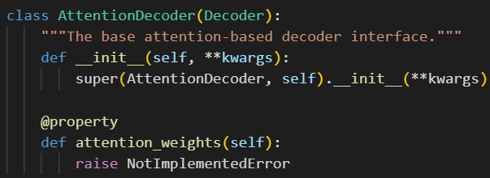
what is different now?
we use Bahdanau attention to redefine the decoder !
same as in lab 10
same as in lab 10
same as in lab 10
this is new !

Slide 21
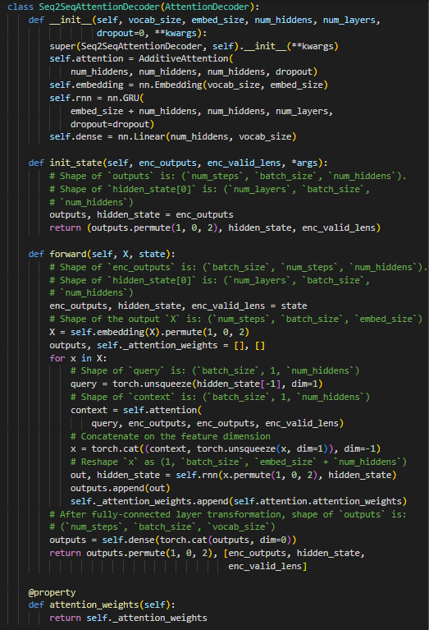

same as in lab 10
these are specified in the problem
this is the model used for training ☺
we need to use 6 classes to obtain it
this is new !

Slide 22
Now, before we start the Transformer part, let’s see some good tutorials…

Slide 23
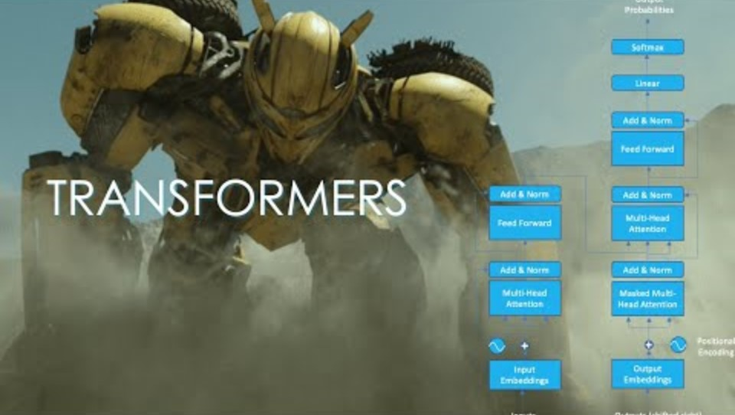
Part 1
https://www.youtube.com/watch?v=dichIcUZfOw

Slide 24
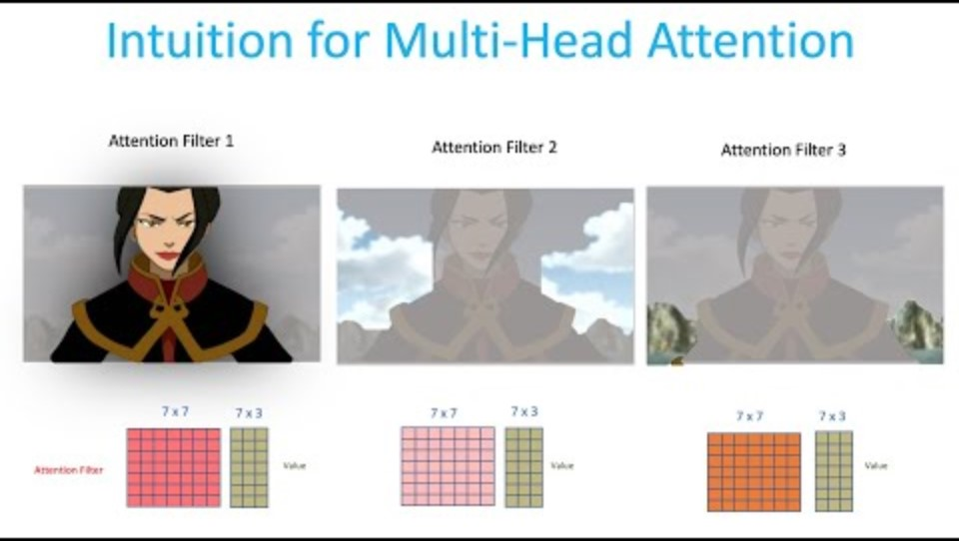
Part 2
https://www.youtube.com/watch?v=mMa2PmYJlCo&t=14s

Slide 25

Part 3
https://www.youtube.com/watch?v=gJ9kaJsE78k&t=172s

Slide 26
4) Multi-head attention

Slide 27
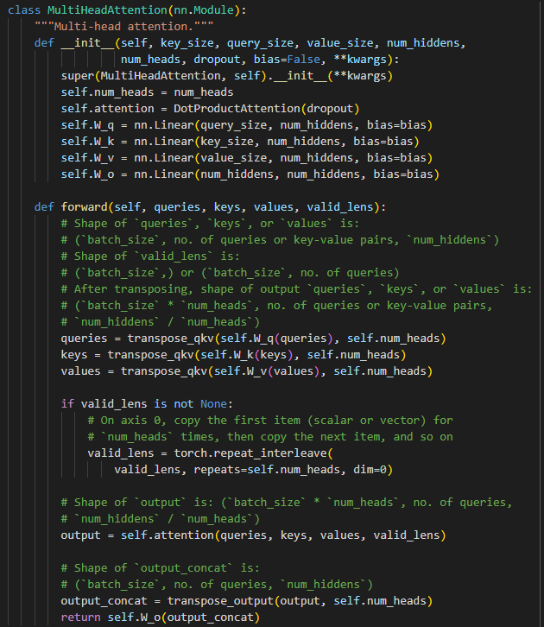
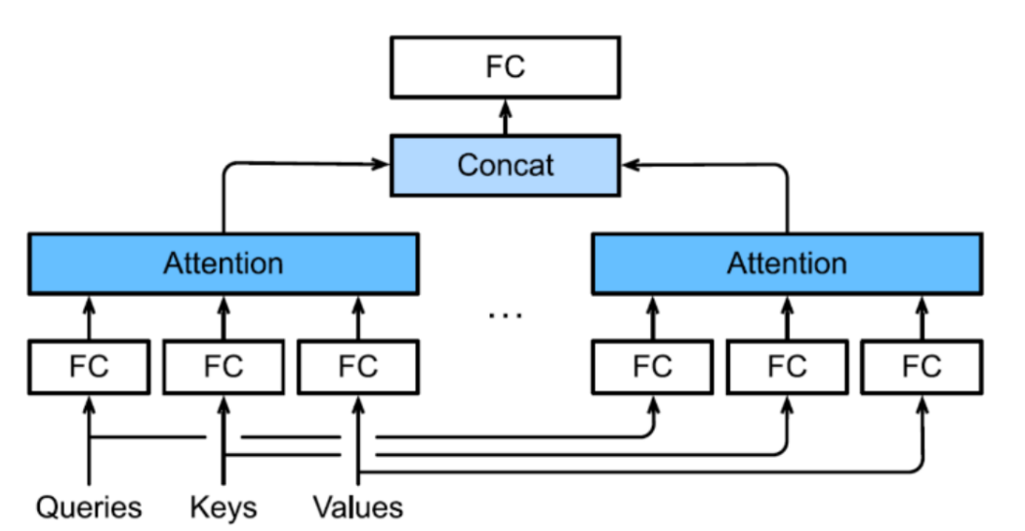

Slide 28
5) Self-attention and positional encoding

Slide 29

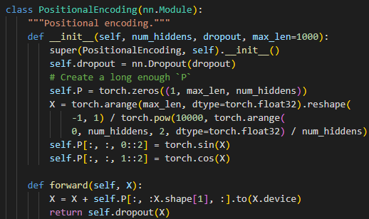
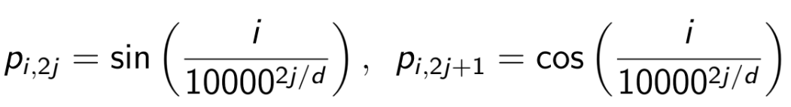
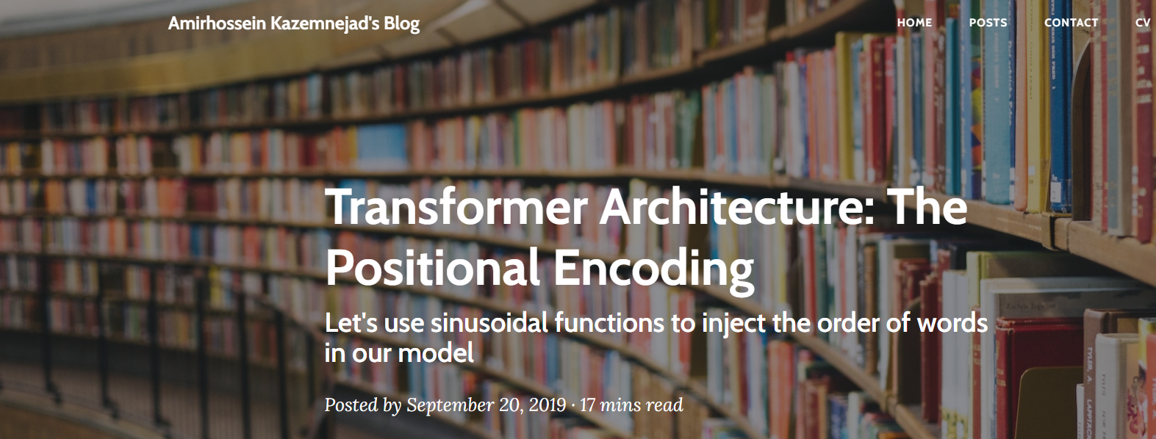
self-attention: queries, keys and values are from the same source:
https://kazemnejad.com/blog/transformer_architecture_positional_encoding/

Slide 30
6) Transformer

Slide 31
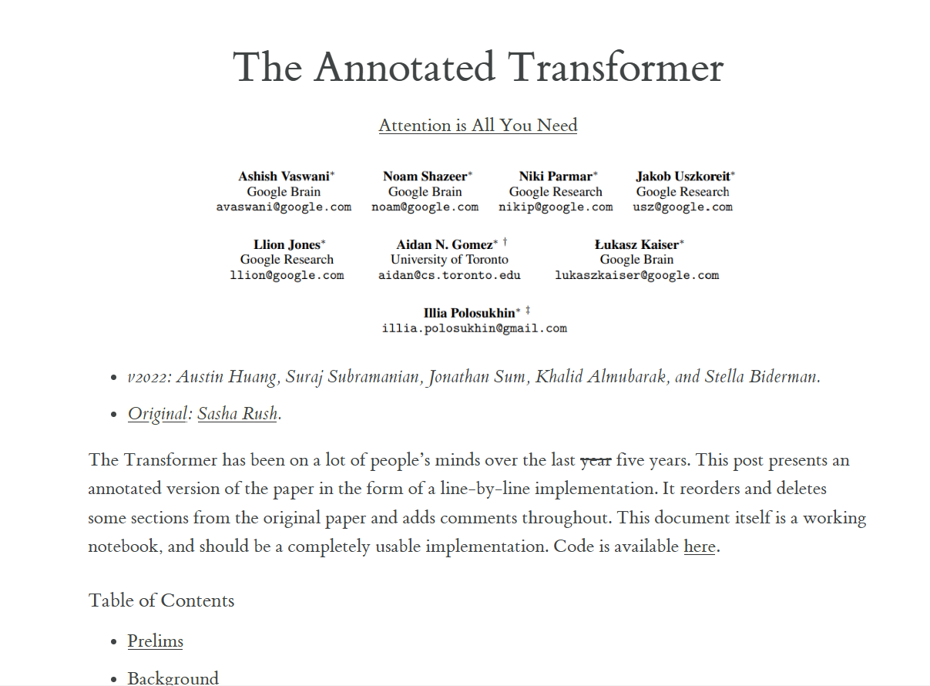
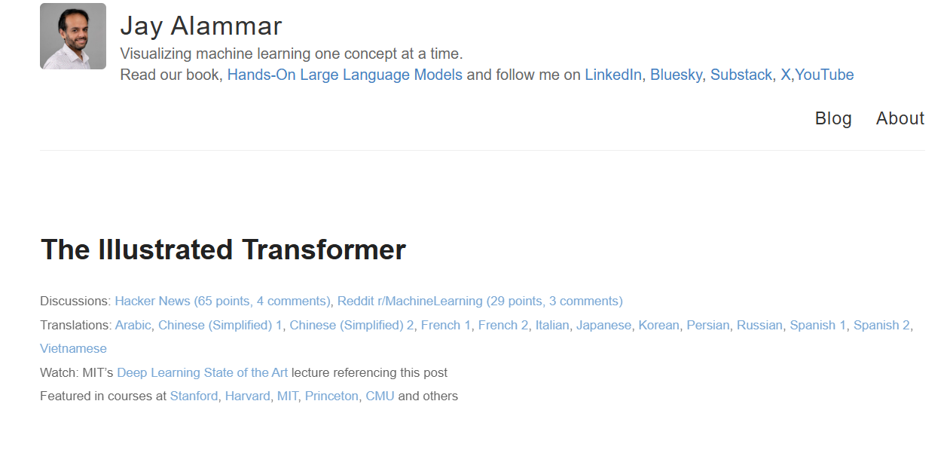
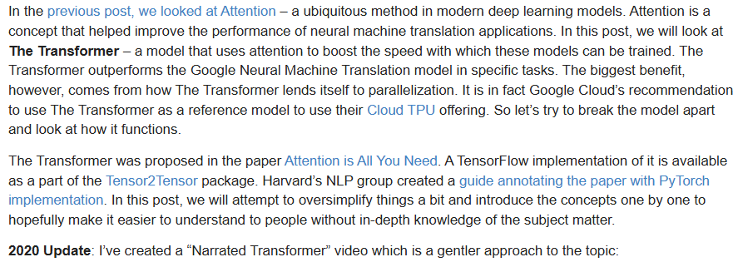
https://nlp.seas.harvard.edu/annotated-transformer/
https://jalammar.github.io/illustrated-transformer/

Slide 32
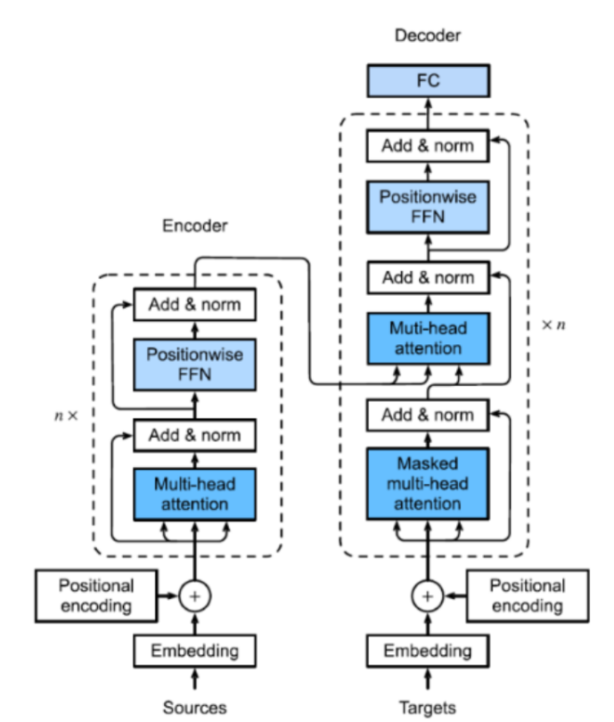
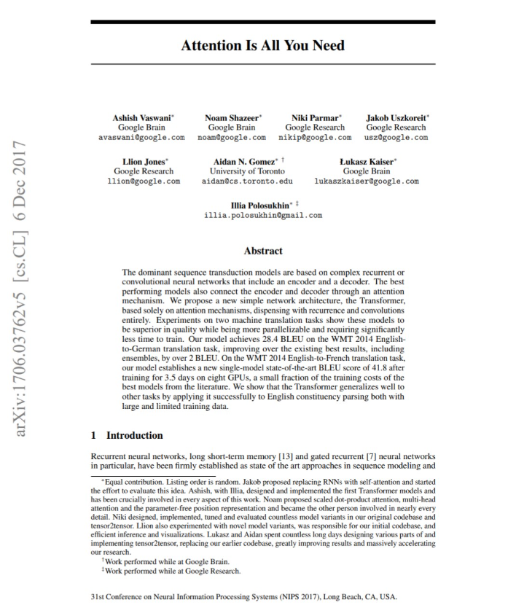

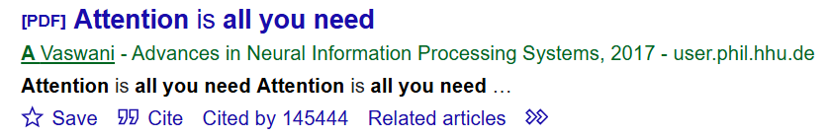

Ashish Vaswani

Slide 33
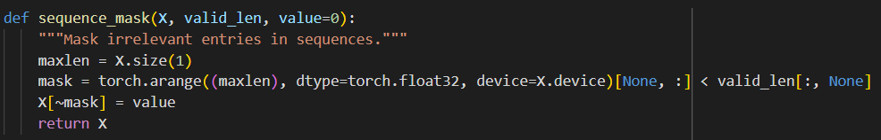
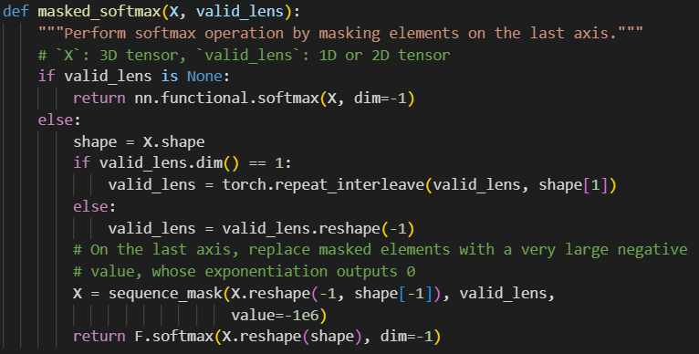
Masking

Slide 34
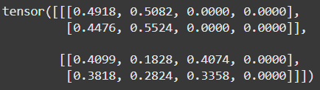
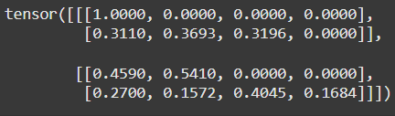




Example
values beyond index 2 are all masked as zero
values beyond index 3 are all masked as zero
values beyond indices 1 and 3 are all masked as zero
values beyond indices 2 and 4 are all masked as zero

Slide 35
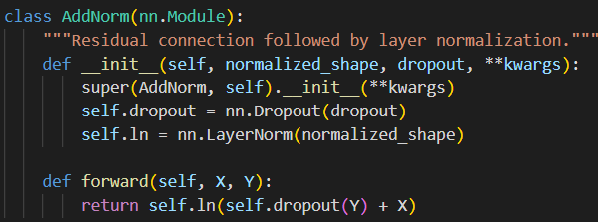

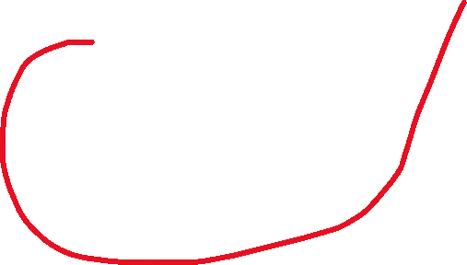


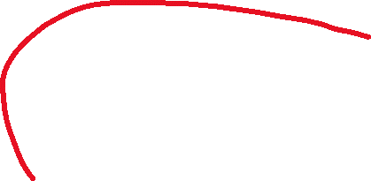
Create the Transformer model in code

Slide 36
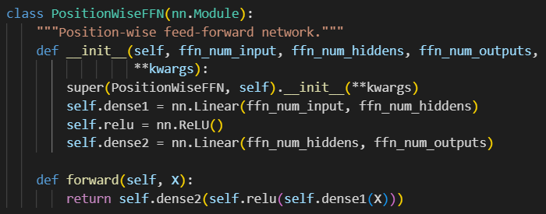

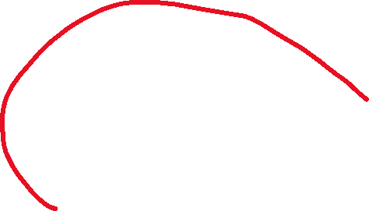
Create the Transformer model in code

Slide 37
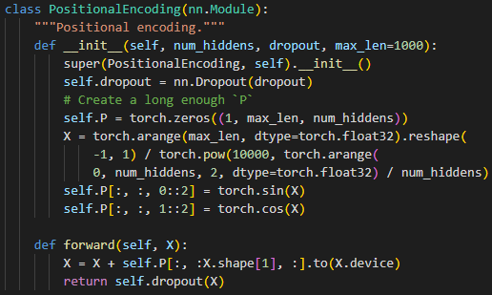


Create the Transformer model in code

Slide 38
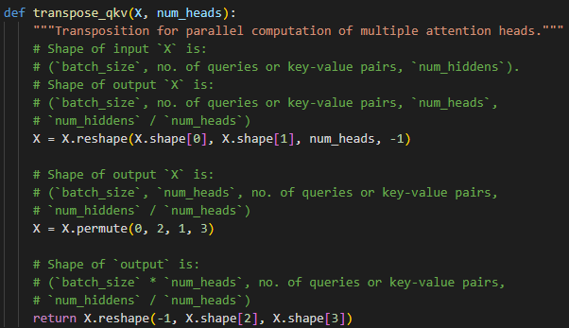
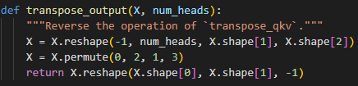

Create the Transformer model in code

Slide 39
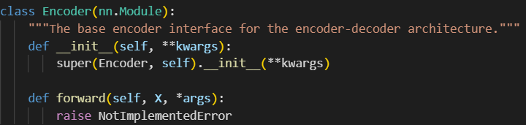
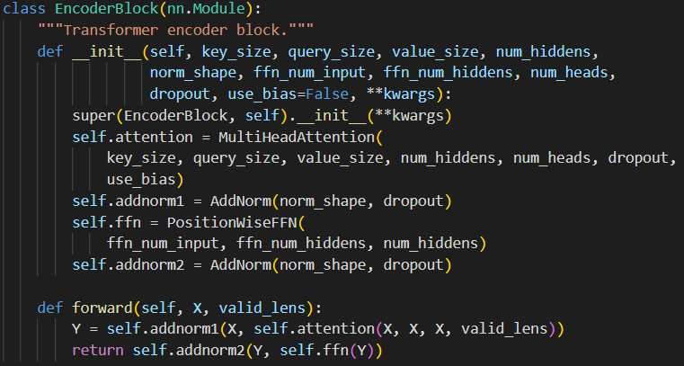



Create the Transformer model in code

Slide 40




Create the Transformer model in code

Slide 41


Create the Transformer model in code
putting everything together:
just 12 classes and 4 functions to copy-paste ☺

Slide 42
Exercises

Slide 43


Slide 44




Solutions
I changed this because x_train is in range [0, 5] and we need to generate 100 testing examples

Slide 45




this is something optional, just in case you want to visualize the training data
it’ s just an adaptation from plot_kernel_reg() function from the lab
I changed only the limits for Ox and Oy axis ☺
copy-paste from lab ☺

Slide 46





Slide 47



create the Transformer model (a lot of classes and functions):

Slide 48



Slide 49



Slide 50



Slide 51




Slide 52





Slide 53



Slide 54



Slide 55



only 15 classes and 18 functions to copy-paste ☺

Slide 56

Thank you for your !

